Slide 1
Raising Your Country’s Happiness
An app that facilitates fundamental policy decisions

Slide 2
Government of Bangladesh is interested in increasing the subjective well being of their people
It’s important to make our people happy!

Slide 3
Is there a need to do anything to make our people happier?
Maybe they are already pretty happy?
If they are not – what aspects of our country’s life should we focus on?
What socio-economic indicators are important for people’s happiness?
And which of them are important for us?
Fortunately, we’ve heard of that nifty online Machine Learning App based on the data from …

Slide 4
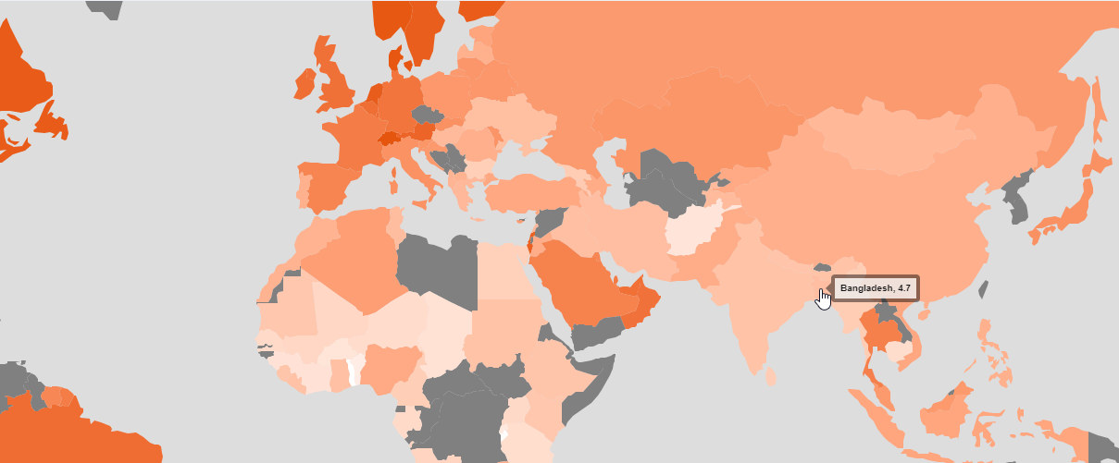
Maybe our people are already happy? How does our country compare to the rest of the world/region on Happiness?
Not so well! Our score is just 4.7 – a lot of room for improvement!

Slide 5
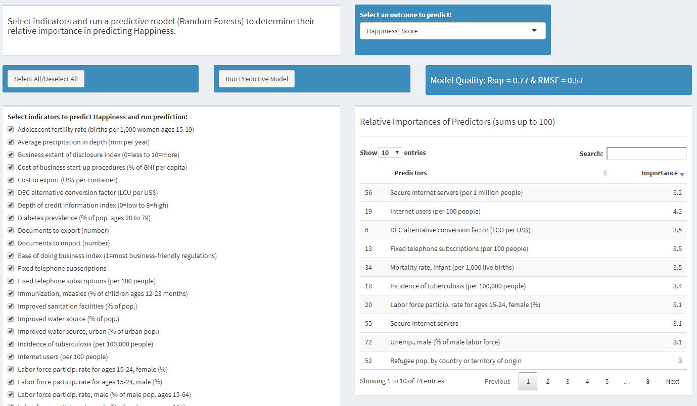
OK, their predictive model has 74 socio-economic indicators. And how well do those – as a group – predict Happiness?
Wow, quite well: an R² of 0.77 is very impressive!

Slide 6
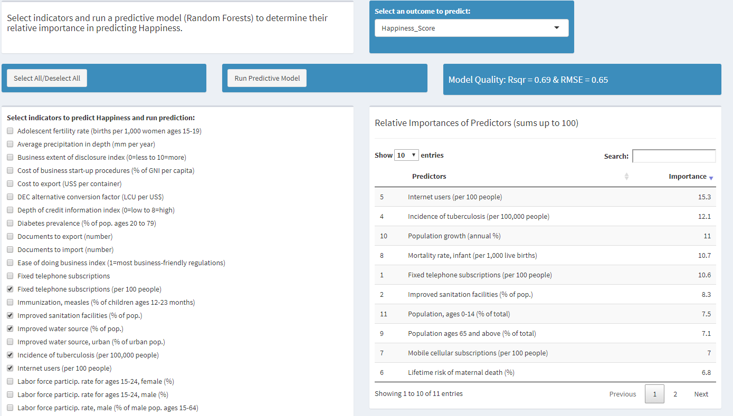
We can’t focus on all indicators, but are ready to consider 13. How well do those predict Happiness?
Incredibly well! An R² of 0.69! And the RMSE decreased from 0.57 to just 0.65!
We were very smart to select those few indicators!
And we can see the most important predictors of Happiness!

Slide 7
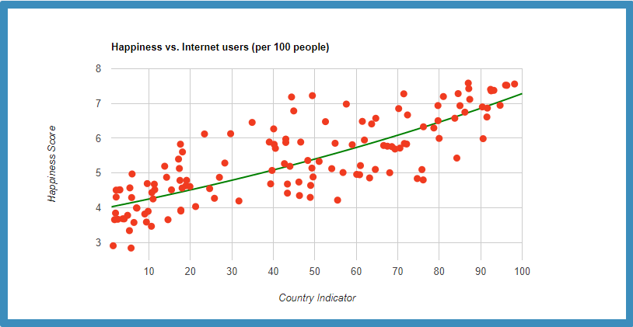
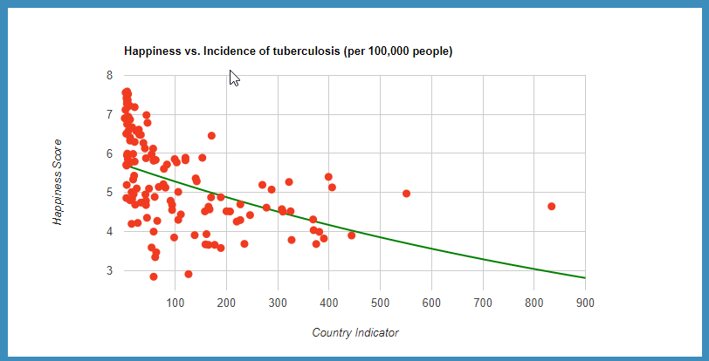


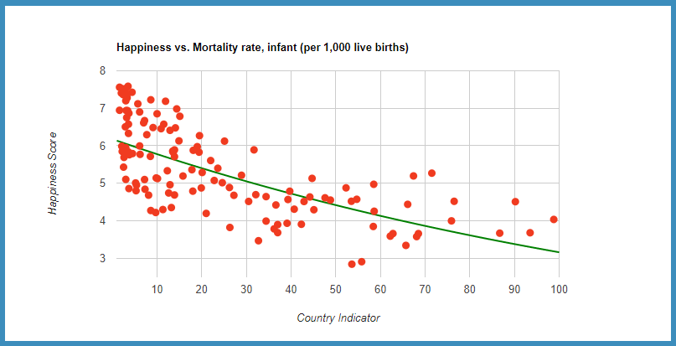
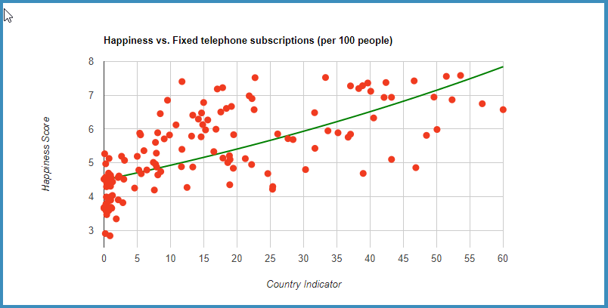


But how exactly are those indicators related to Happiness?
Ah, some of them are related positively and some – inversely.

Slide 8
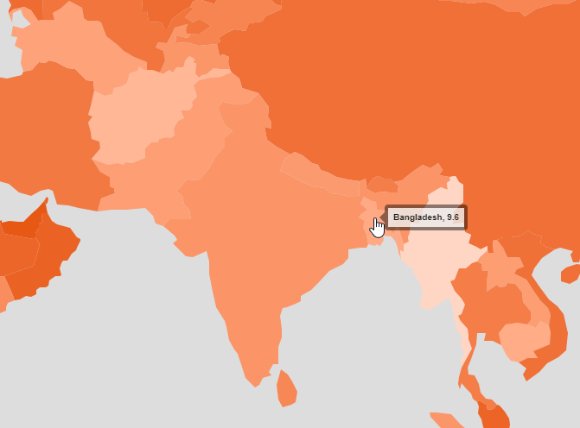
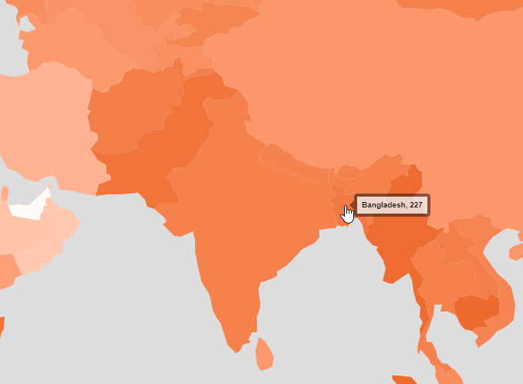
Where do we stand on those indicators compared to other countries in the world/region?
Not so great on Internet Usage; still quite high incidence of tuberculosis
Internet Users (per 100 people)
Incidence of Tuberculosis (per 100,000 people)

Slide 9
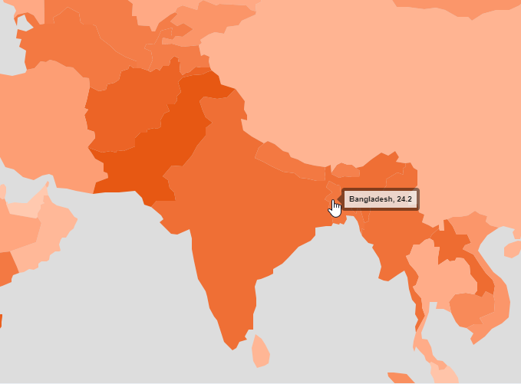
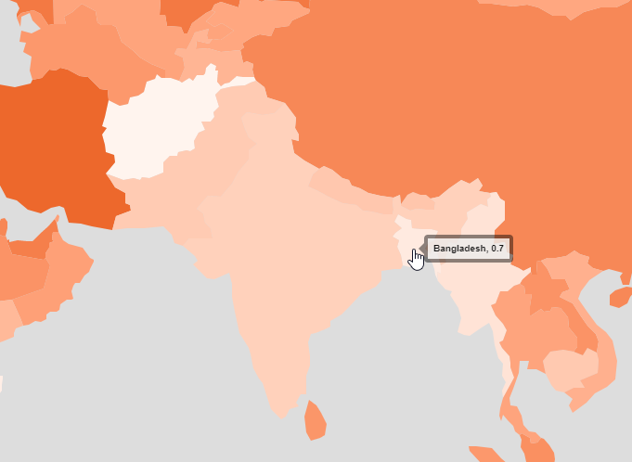
Where do we stand on those indicators compared to other countries in the world/region? (cont’d)
Relatively high mortality rate; very low number of fixed phone subscriptions
Infant mortality rate ( per 1,000 live births)
Fixed telephone subscriptions (per 100 people)

Slide 10
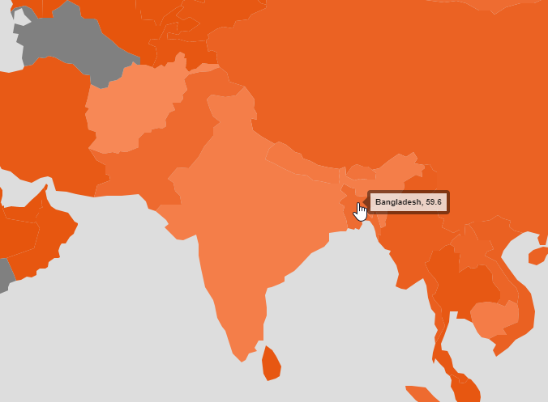
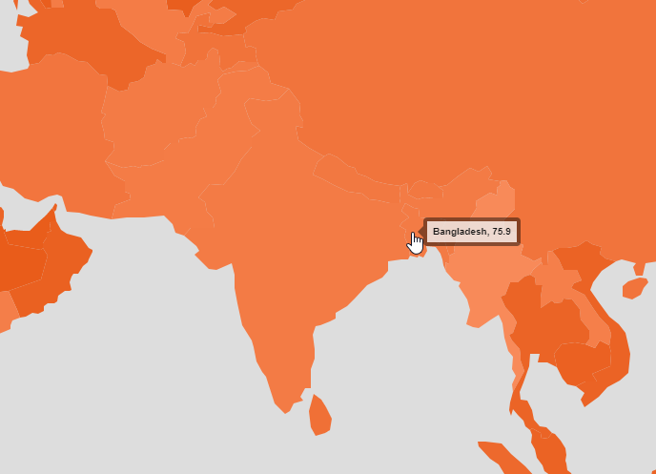
Where do we stand on those indicators compared to other countries in the world/region? (cont’d)
Relative success on improved sanitation facilities and on cellular subscriptions
Improved sanitation facilities (% of population)
Mobile cellular subscriptions (per 100 people)

Slide 11
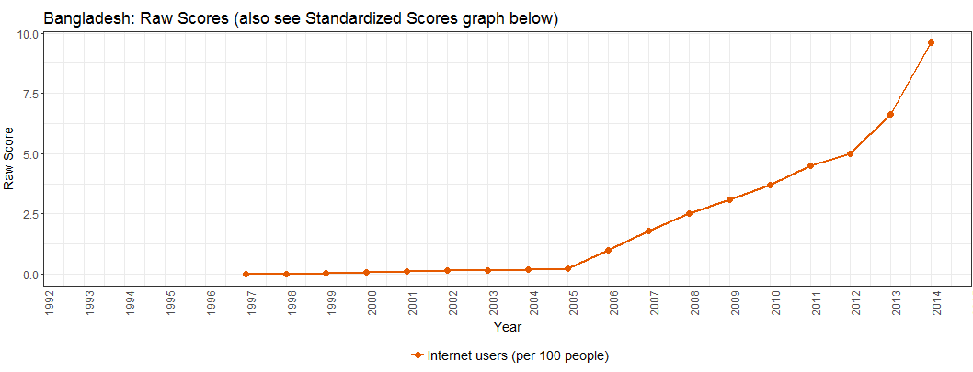
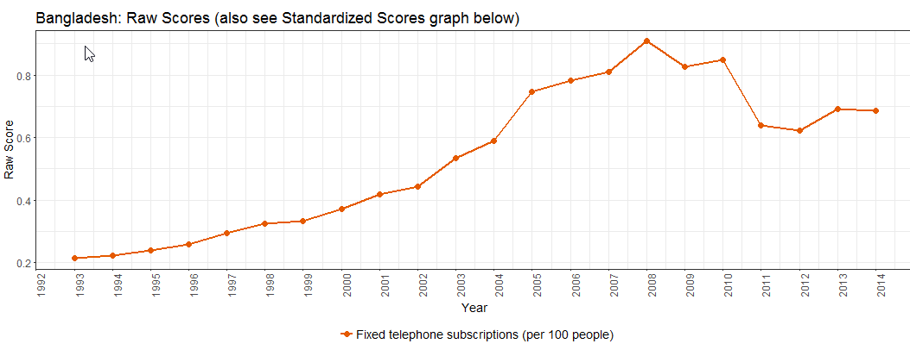
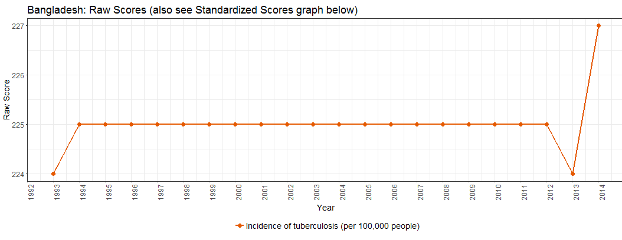
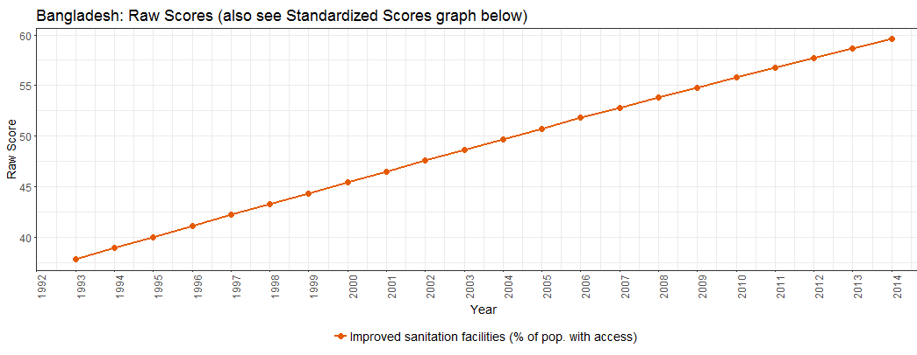
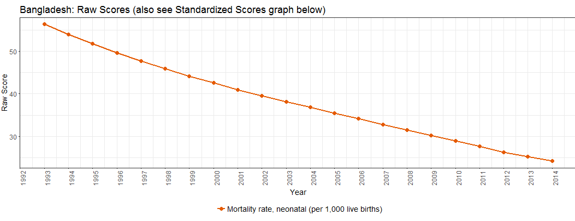
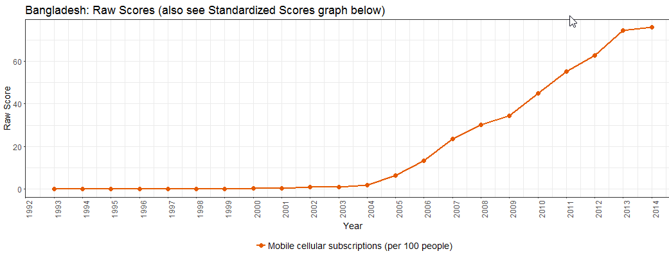
Our trends over time? Little improvement in tuberculosis incidence and number of fixed phone subscriptions
Improvements in Internet use, access to sanitation, & mobile phone usage; falling mortality rates

Slide 12
Summary of top predictors of Happiness, our absolute standing on them (vs. others) and our trends over time
Overall, our primary focus should be on improving public health: esp, fighting tuberculosis, and lowering infant mortality rate; and improving fixed phone line infrastructure.
Indicator | Impor-tance | Absolute Standing | Trend over time
Internet Users (per 100 people) | 15
Incidence of Tuberculosis (per 100,000 people) | 12
Infant mortality rate ( per 1,000 live births) | 11
Fixed telephone subscriptions (per 100 people) | 11
Improved sanitation facilities (% of pop.) | 8
Mobile cellular subscriptions (per 100 people) | 7

Slide 13
Appendix

Slide 14
About World Happiness Score and World Development Indicators
WHR has was published in 2012, 2013, 2015, and 2016
World Happiness Scores:
Used regularly by the World Happiness Report.
The actual happiness scores and rankings come from the Gallup World Poll.
The exact wording of the “happiness” question is:
“Please imagine a ladder, with steps numbered from 0 at the bottom to 10 at the top. The top of the ladder represents the best possible life for you and the bottom of the ladder represents the worst possible life for you. On which step of the ladder would you say you personally feel you stand at this time?”
This app used the World Happiness Scores and rankings for 2015 posted on Kaggle.
World Development Indicators:
Are collected and published yearly by the World Bank.
This app used the data on 74 indicators from 1993 to 2014 posted on Kaggle.

Slide 16
World Happiness Report

